Slide 1
CSSE3113 – Introduction To Software Engineering
UML Diagrams

Slide 2


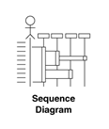
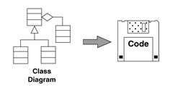
Beginnings of a Method
Systems Model

Slide 3
Interaction Models
All systems involve interaction of some kind…
This can be user interaction, which involves user inputs and outputs
Interaction between the system being developed and other systems
Or interaction between the components of the system
Use case modeling, which is mostly used to model interactions between a system and external actors (users or other systems).
Sequence diagrams, which are used to model interactions between system components, although external agents may also be included.

Slide 4
UML Sequence Diagrams
Describe the flow of messages, events, actions between objects
Show time sequences that are not easily depicted in other diagrams
Typically used to understand the logical flow of system
Emphasis on time ordering!

Slide 5
Sequence Diagram Key Parts
In a sequence diagram, objects and actors are aligned along the top of the diagram.
Labeled arrows indicate operations; the sequence of operations is from top to bottom.
The axes in a sequence diagram:
– horizontal: which object/participant is acting
– vertical: time

Slide 6
Developing Sequence Diagrams
Identify the relevant objects involved in the computation
Establish the role of each object
Identify the controller
Decide messages between objects

Slide 7
Sequence Diagram Notation
Object1 name:classname
Object 2name:classname
Actors
Objects

Slide 8
Sequence Diagram Notation
:Object 1
:Object 2
Lifelines
Identify the existence of the object over time.

Slide 9
Sequence Diagram Notation
:Object 1
:Object 2
Activations
Indicate when an object is performing an action

Slide 10
Sequence Diagram Notation
:Object 1
:Object 2
message
Messages
Indicate the communications between objects

Slide 11
Sequence Diagram Notation
:Object 1
:Object 2
message
message
Sequence
Vertical position signifies sequence – earlier messages appear nearer the top.

Slide 12
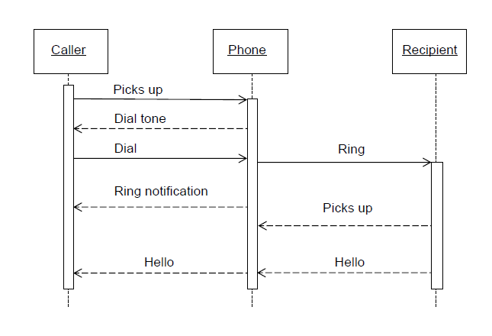
Sequence Diagram (make a phone call)

Slide 13
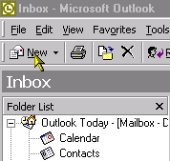
A Simpler Example - Sending an email

Slide 14
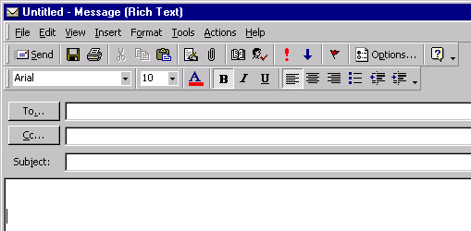
E-mail Interface

Slide 15
Working From a Scenario
Sending an email
1. Press “New ” email icon
2. Enter person’s name in “To” section
3. Type subject
4. Type contents
5. Press Send button
6. System looks up email address in address book
7. System submits the email to the email server

Slide 16
Starting The Diagram
If this is an interactive scenario, we always have an actor driving it

Slide 17
Add Objects
The first interaction is with the icon bar, which we can treat as an
object

Slide 18
Add Message
The user talks to the icon bar

Slide 19
Label The Communication
Remember that actors can only communicate with interface objects such as screens, menus and icon bars.

Slide 20
The icon bar has some work to do.
It creates an email page.
Now the user can see the email page and use it.

Slide 21
The next three steps are filling in the details on the email page

Slide 22
The User then clicks Send

Slide 23
Now consider how to do the sending
We can choose to get the email page to look up the email address from an address book object

Slide 24
The arrow allows information to return
So we don’t need to put a return arrow with the email address going back to the email page

Slide 25
We can choose to get the email page to submit the email to the email server

Slide 26
And if we think carefully, the email page always closes after the send.

Slide 27
Now we go through and change the messages to operations on the object

Slide 28
And so on, all the way through

Slide 29
And now we have found our objects, and the operations on them
So we drag them onto a class diagram

Slide 30
Exercise
Consider the following scenario and draw sequence diagram for online book shop.
“Online customer can search book catalog, view description of a selected book, add book to shopping cart, do checkout”.

Slide 31
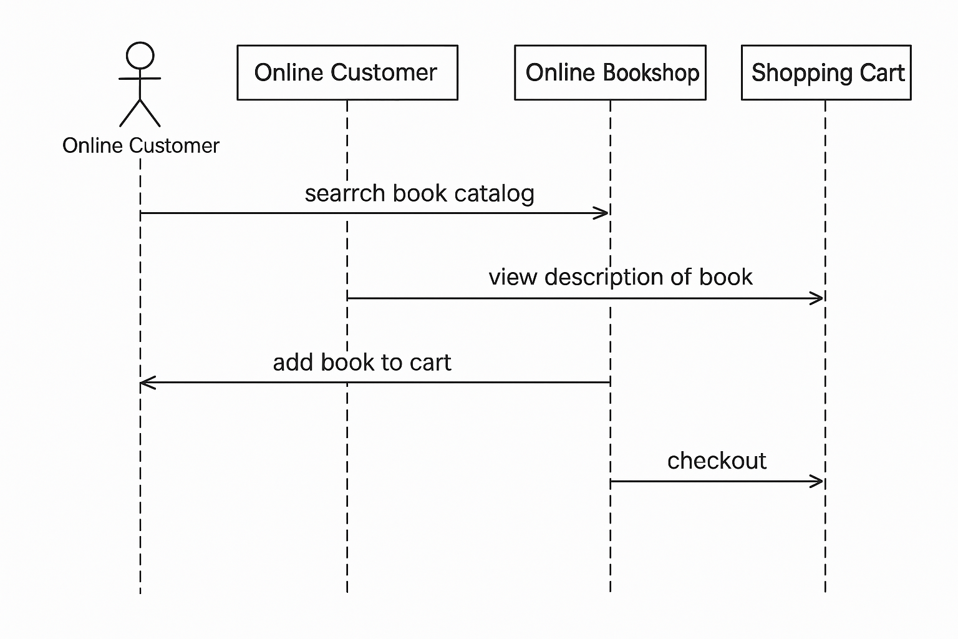
Solution

Slide 32
Entity/Relationship Modelling
ERD is a data modeling technique used in software engineering to produce a conceptual data model of an information system.
Illustrate the logical structure of database.
It describe how these data are related to each other.
For example, the entities writer, novel, and consumer may be described using ER diagrams this way:

Slide 33
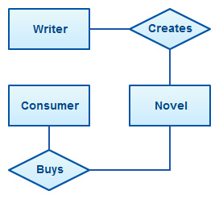
Entity/Relationship Modelling

Slide 34
Entity/Relationship Modelling
E/R Modelling is used for conceptual design
Entities - objects or items of interest
Attributes - Properties of an entity
Relationships - links between entities
Example
In a University database we might have entities for Students, Modules and Lecturers. Students might have attributes such as their ID, Name, and Course, and could have relationships with Modules (enrolment) and Lecturers.

Slide 35
Entity/Relationship Diagrams
E/R Models are often represented as E/R diagrams
Lecturer
ID
Name
Ph#
teaches
Student
Course
Register

Slide 36
Entities
Entities represent objects or things of interest
Physical things like students, lecturers, employees..
More abstract things like modules, orders, courses, projects
Entities have
A general type or class, such as Lecturer or Module
Instances of that particular type, such as Steve Mills, Natasha are instances of Lecturer
Attributes (such as name, email address)

Slide 37
Entities
In an E/R Diagram, an entity is usually drawn as a box with rounded corners or Rectangle
The box is labelled with the name of that entity
Lecturer
ID
Name
PH#
teaches
Student
course
Register

Slide 38
Attributes
Attributes are properties, or details about an entity
Students have IDs, names, courses, addresses, …
Courses have codes, titles, credit weights. .…

Slide 39
Diagramming Attributes
In an E/R Diagram attributes may be drawn as ovals
Each attribute is linked to its entity by a line
The name of the attribute is written in the oval
Lecturer
ID
Name
Ph#
Teaches
Student
Course
Register

Slide 40
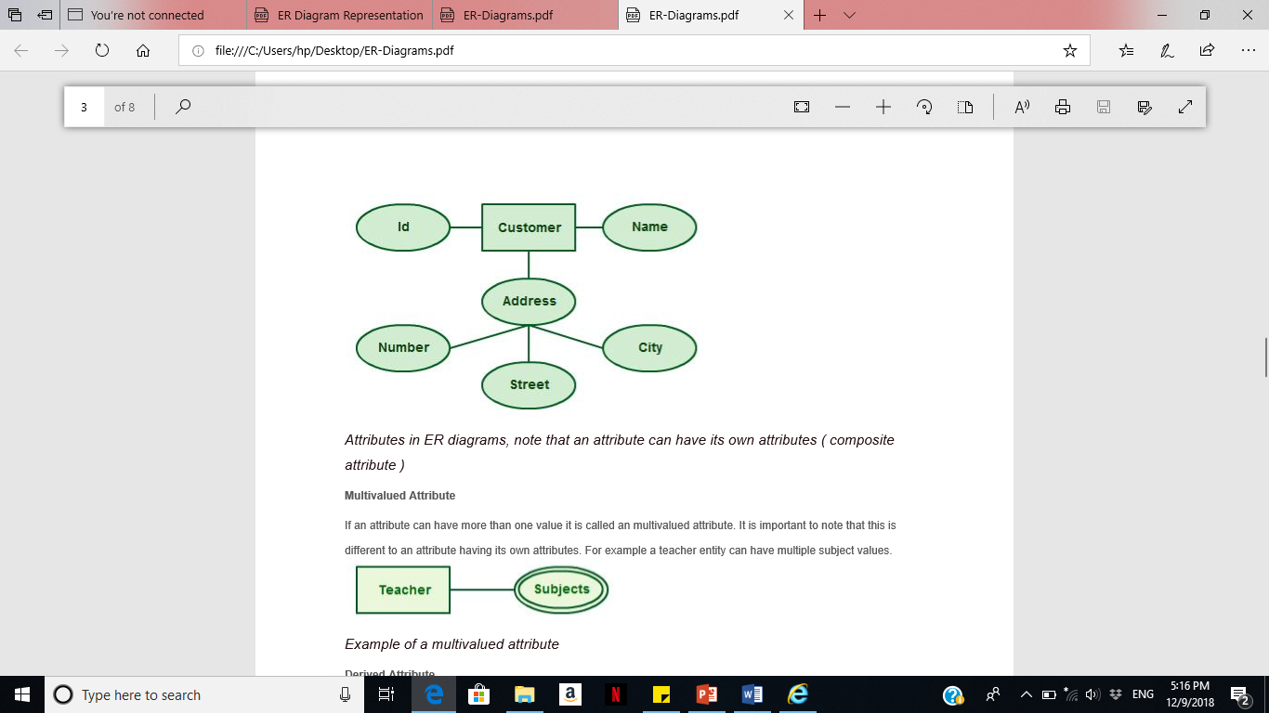
Types of Attributes
Composite attributes
Attributes can also have their own specific attributes. For example, the attribute “customer address” can have the attributes “number, street, city, and state”.

Slide 41
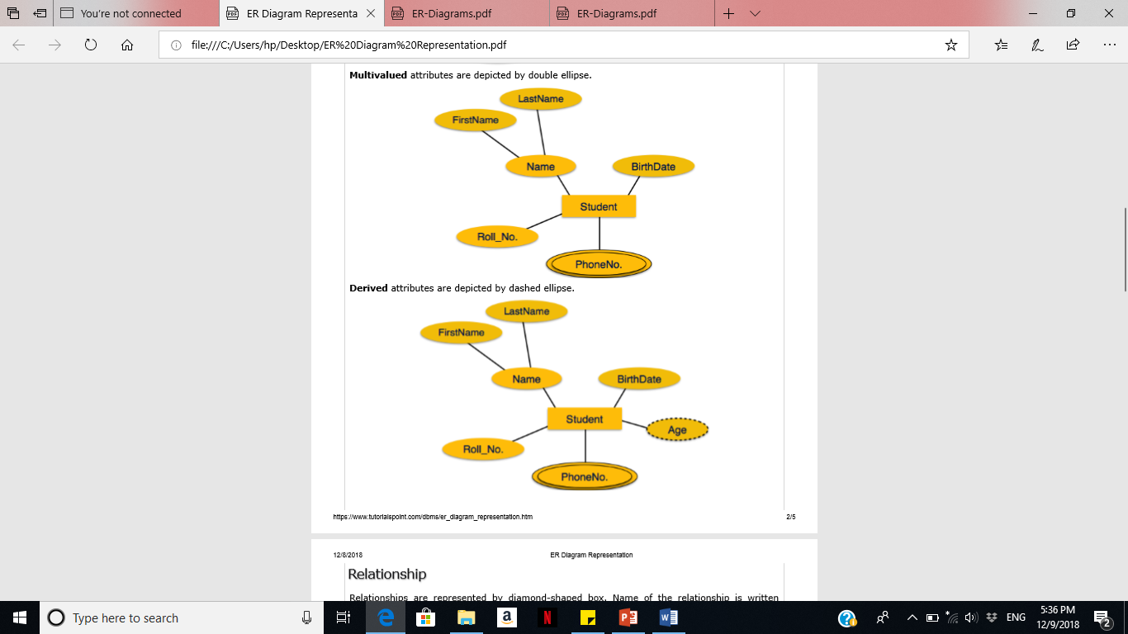
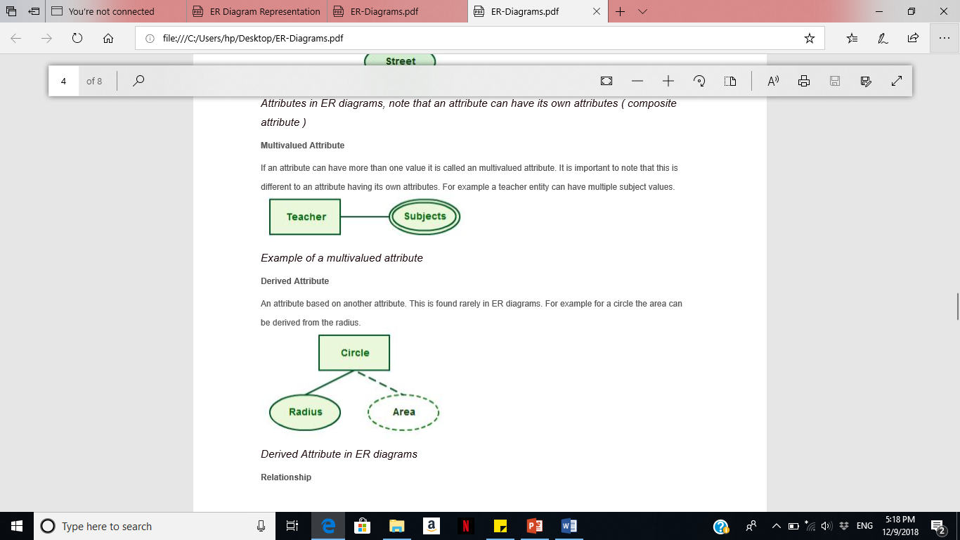
Types of Attributes
Multivalued Attribute
If an attribute can have more than one value it is called an multivalued attribute.
For example a teacher entity can have multiple subject values.

Slide 42
Types of Attributes
Derived Attribute
An attribute based on another attribute. This is found rarely in ER diagrams. For example for a circle the area can be derived from the radius.

Slide 43
Relationships
Relationships are an association between two or more entities
Each Student takes several Courses
Each Course is taught by a Lecturer
Each Employee works for a single Department
Relationships have
A name
A set of entities that participate in them
A degree - the number of entities that participate (most have degree 2)
A cardinality ratio

Slide 44
Cardinality Ratios
Each entity in a relationship can participate in zero, one, or more than one instances of that relationship
This leads to 3 types of relationship…
One to one (1:1)
Each lecturer has a unique office
One to many (1:M)
A lecturer may teaches many students, but each student has just one tutor for specific course
Many to many (M:M)
Each student takes several courses and each course is taken by several students

Slide 45
Diagramming Relationships
Relationships are links between two entities
The name is given in a diamond box
The ends of the link show cardinality
Lecturer
ID
Name
Ph#
Teaches
Student
Course
Register
One
Many

Slide 46
Making E/R Models
To make an E/R model you need to identify
Entities
Attributes
Relationships
Cardinality ratios
from a description
General guidelines
Since entities are things or objects they are often nouns in the description
Attributes are properties, and often nouns
Verbs often describe relationships between entities

Slide 47
Example
We want to represent information about products in a database. Each product has a Product id, description, and price. Supplier supply the products.
Supplier have address, phone numbers, and name. Each address is made up of a street address, a city, and a postcode.

Slide 48
Data Flow Diagram (DFD)
The distinguishing features of DFDs are as follows:
Data flow diagrams capture the flow of data in a system.
It describes data origination, transformations and consumption in a system.

Slide 49
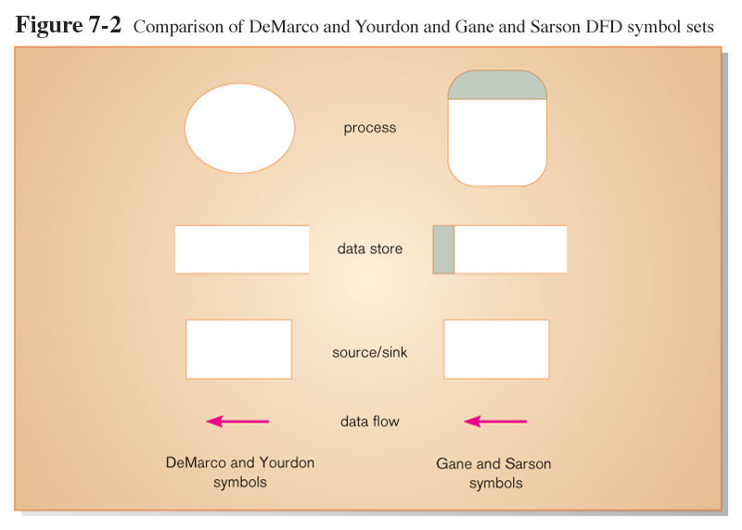
The DFD Notation

Slide 50
DFD Components
DFDs consist of four basic components that illustrate how data flows in a system: entity, process, data store, and data flow.
Process: work or actions performed on data (inside the system).
Data Store: Data at rest (inside the system).
Source/ Sink (Entity): External entity that is origin or destination of data (outside the system).
Data flow: arrows depicting movement of data.

Slide 51
DFD Components
Entity:
An entity is the source or destination of data. The source in a DFD represents these entities that are outside the context of the system. Entities either provide data to the system (referred to as a source) or receive data from it (referred to as a sink).
Process:
The process is the manipulation or work that transforms data. In other words, a process receives input and generates some output. Process names (simple verbs and dataflow names, such as “Submit Payment” or “Get Invoice”).

Slide 52
DFD Components
Data Store:
A data store is where a process stores data between processes for later retrieval by that same process or another one. Files and tables are considered data stores. Data store names (plural) are simple but meaningful, such as “customers,” “orders,” and “products.”
Data Flow:
Data flow is the movement of data between the entity, the process, and the data store. Data flow portrays the interface between the components of the DFD. The flow of data in a DFD is named to reflect the nature of the data used (these names should also be unique within a specific DFD).

Slide 53
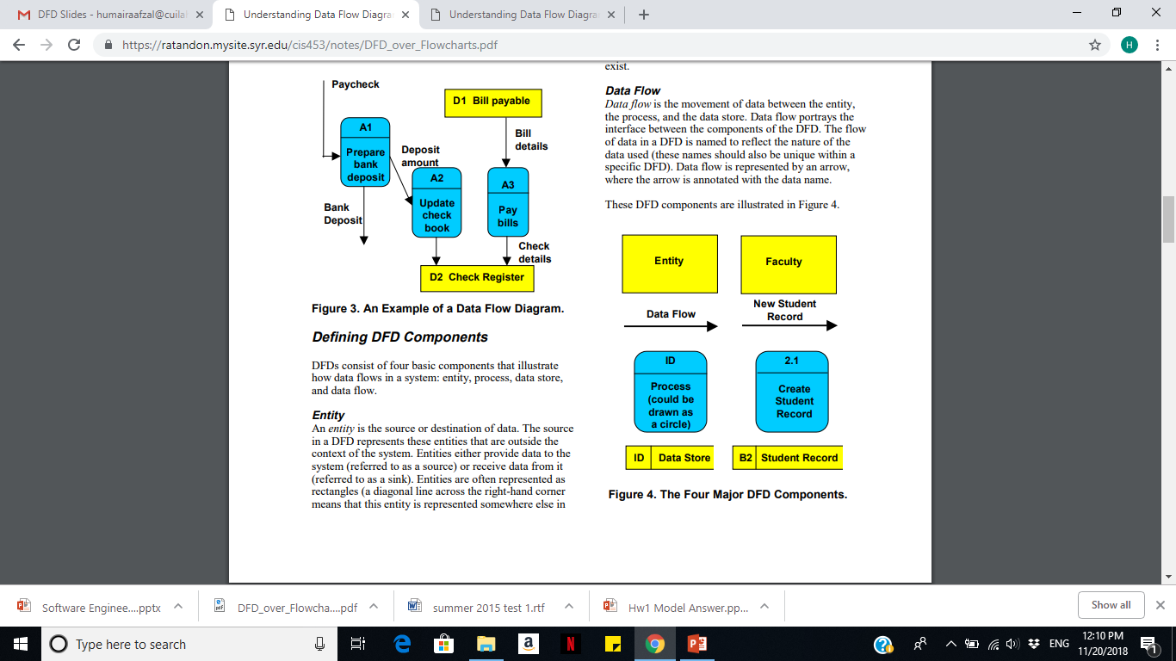
DFD Components

Slide 54
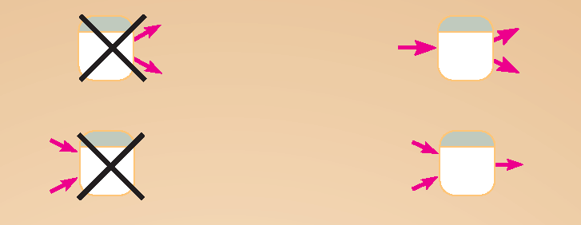
DFD Diagramming Rules (Process)
No process can have only outputs or only inputs. Processes must have both outputs and inputs.
Process labels should be verb phrases.

Slide 55
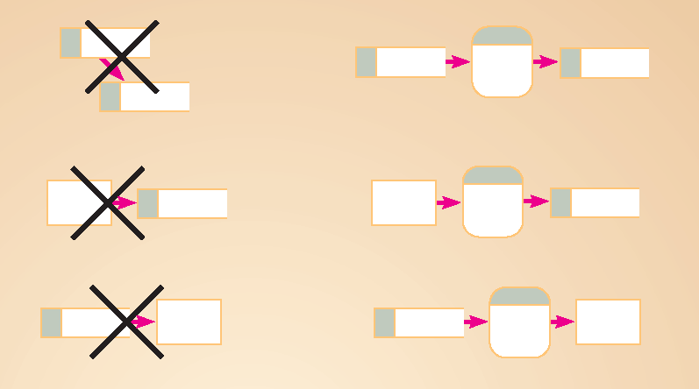
DFD Diagramming Rules (Data Stores)
All flows to or from a data store must move through a process.
Data Store labels should be noun phrases.

Slide 56
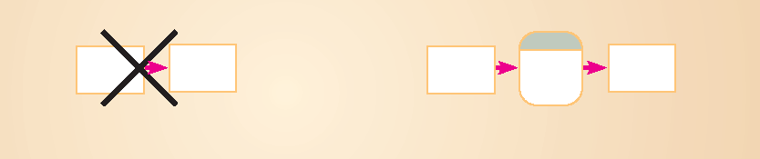
DFD Diagramming Rules (Source/Sink)
No data moves directly between external entities without going through a process.
Source and Sink labels should be noun phrases.

Slide 57
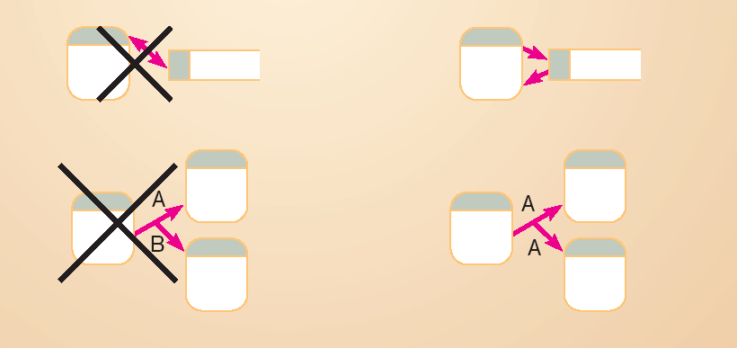
DFD Diagramming Rules (Dataflow)
Bidirectional flow between process and data store is represented by two separate arrows.

Slide 58
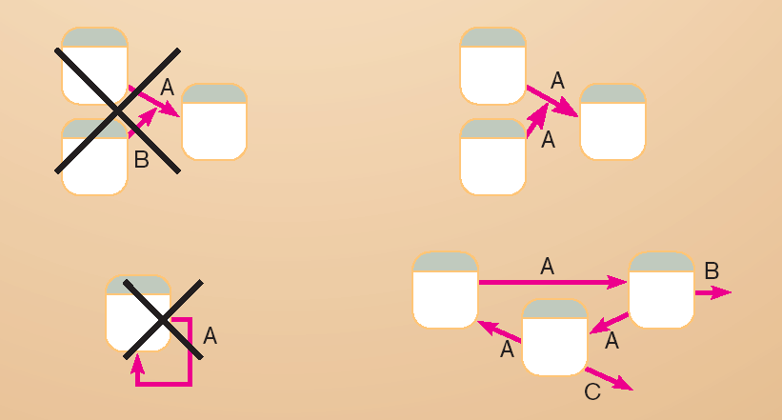
DFD Diagramming Rules (Dataflow)
Data flow cannot go directly from a process to itself, must go through intervening processes.

Slide 59
DFD Diagramming Rules (Dataflow)
Data flow from a process to a data store means update (insert, delete or change).
Data flow from a data store to a process means retrieve or use.

Slide 60
DFD Levels
Context DFD / Level-0 DFD
Level-1 DFD
Level-n DFD

Slide 61
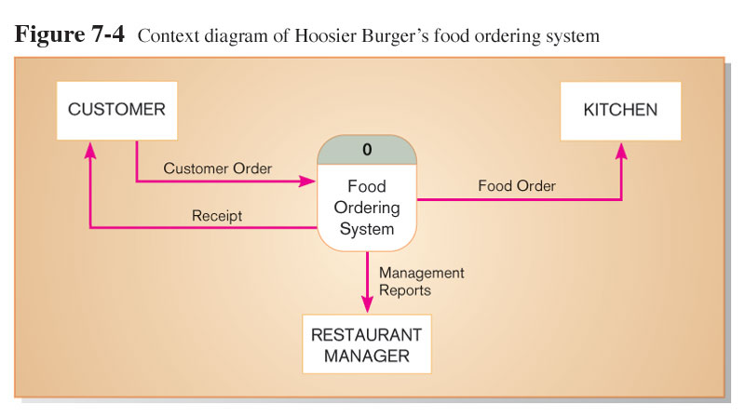
Context Diagram of Burger’s food ordering system
Context diagram shows the system boundaries, external entities that interact with the system, and major information flows between entities and the system.
NOTE: only one process symbol

Slide 62
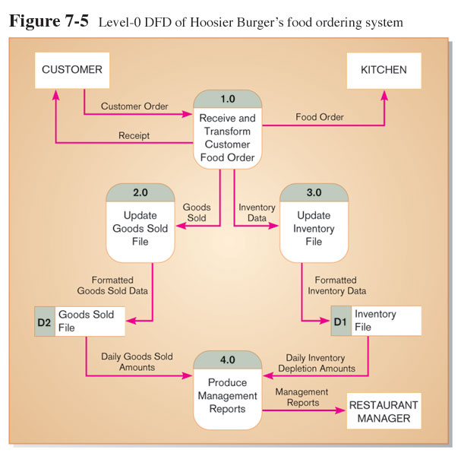
Level-1 DFD
Level-0 DFD shows the system’s major processes, data flows, and data stores at a high level of abstraction.
Processes are labeled 1.0, 2.0, etc. These will be decomposed into more primitive (lower-level) DFDs.

Slide 63
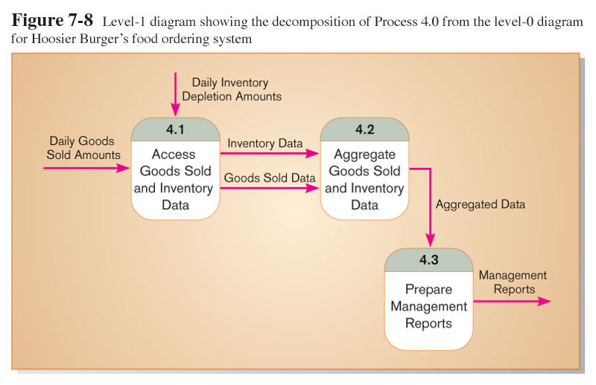
Level-2 DFD
Level-1 DFD shows the sub-processes of one of the processes in the Level-0 DFD.
This is a Level-1 DFD for Process 4.0.
Processes are labeled 4.1, 4.2, etc. These can be further decomposed in more primitive (lower-level) DFDs if necessary.

Slide 64
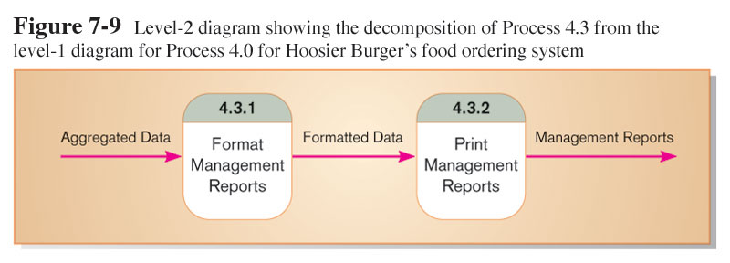
Level-n DFD
Level-n DFD shows the sub-processes of one of the processes in the Level n-1 DFD.
This is a Level-2 DFD for Process 4.3.
Processes are labeled 4.3.1, 4.3.2, etc. If this is the lowest level of the hierarchy, it is called a primitive DFD.

Slide 65
Case Study
Draw a context level data flow diagram for a patient monitoring system.
Process of patient monitoring system:
A patient’s vital signs are transmitted to this system, which may invoke a warning message to the nurse if these signs fall into the critical range. Nurse may request for a report, which the patient monitoring system retrieves from the patient log, and returns it to the nurse again.

Slide 66
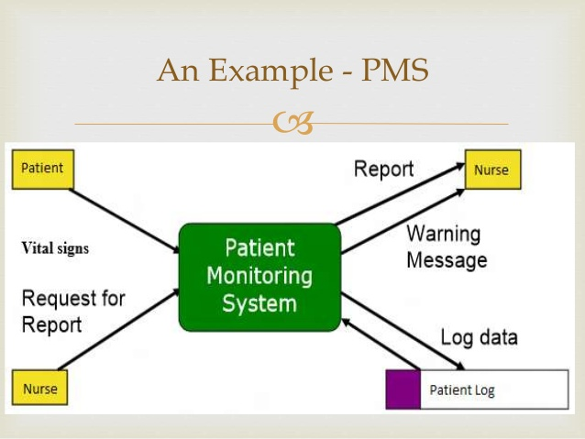

Slide 67
Consider the following case study and answer the questions written at the end of text.
“ Pizza Express wants to install a new software system to record orders for take-away pizza. When customers call Pizza Express on the phone, they are asked about their data and order details. Once the order is taken the total cost (including delivery and any applicable discount) is calculated. A receipt is printed. The order is then given to the chef to make the pizza. Occasionally, special offers (coupons) are printed so that the customer can get a discount. Order details are kept for comparison with last year’s performance.”
Develop the Context Level DFD and DFD Level 1 Diagram for the above scenario.

Slide 68
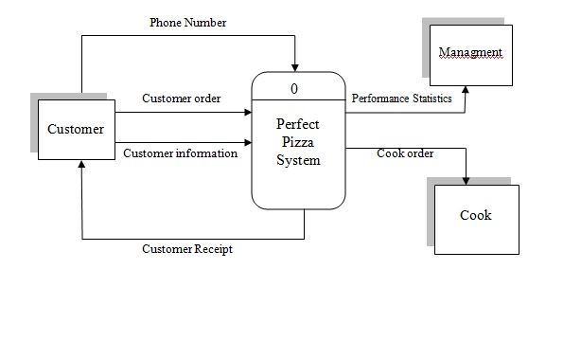
Context Diagram

Slide 69
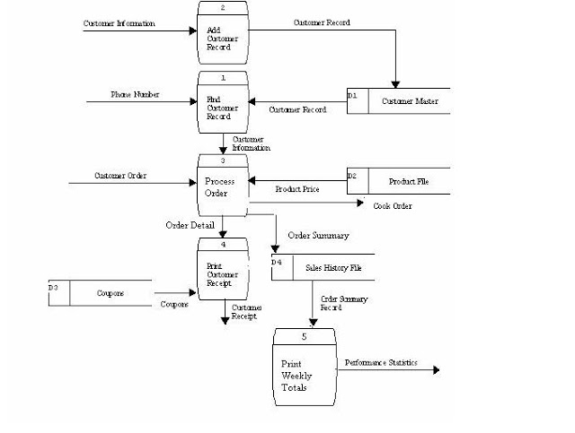
Level 1 DFD

Slide 70
Case Study
Consider a mail order company that distributes CDs and tapes at discount prices to its members.
When an order processing clerk receives an order form, she verifies that the sender is a member by checking the MEMBER FILE.
If the sender is not a member, the clerk returns the order along with a membership application form.
If the customer is a member, the clerk verifies the order item data by checking the ITEM FILE.
Then the clerk enters the order data and saves it to the DAIILY ORDERS FILE.
At the same time the clerk also prints an invoice and shipping list for each order, which are forwarded to the ORDER FULFILLMENT DEPARTMENT for processing there.
Develop the Context Level DFD and DFD Level 1 Diagram for the above scenario.

